Slide 1
Radio Waves

Slide 2
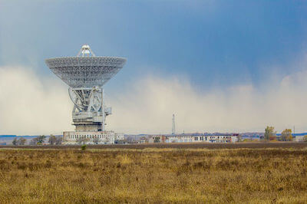
In this Smart lesson you will do the following:
Describe how we transmit signals with radio waves.
Compare AM and FM.

Slide 3
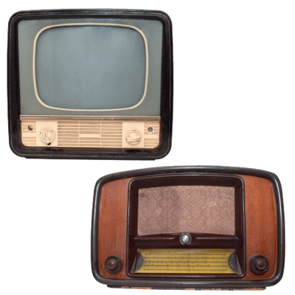
Both radios and televisions use radio waves to receive signals.
The radio waves are produced when electrons oscillate (move backwards and forwards) in a transmitting antenna.
When these radio waves hit the antenna on our radio or television, they cause the electrons in our antenna to oscillate as well. Our radio then turns these oscillations into sound, while our television turns them into light and sound.

Slide 4
Radio waves have a very long wavelength.
Some wavelengths are several kilometres long! Other waves have a wavelength of several metres.

Slide 5
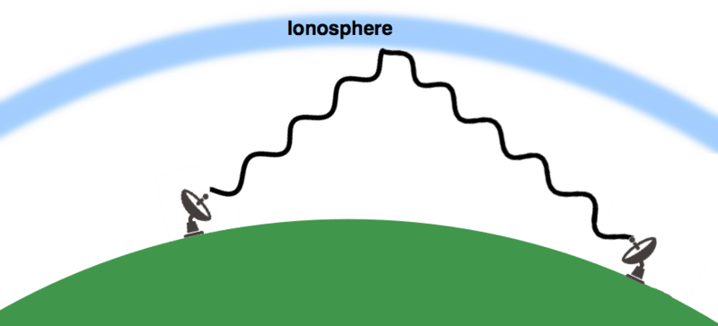
The method by which a radio wave is transmitted can increase the distance it travels.
Radio waves which have a wavelength of around 30 m (short-wave signals) are aimed upwards. They bounce off the ionosphere, which is a layer of the atmosphere, and are reflected back to Earth.

Slide 6

Long-wave radio waves have a wavelength which is several kilometres long.
Long-wave radio signals are transmitted along the ground. They bend to follow the Earth as it curves, enabling long distance communication.

Slide 7
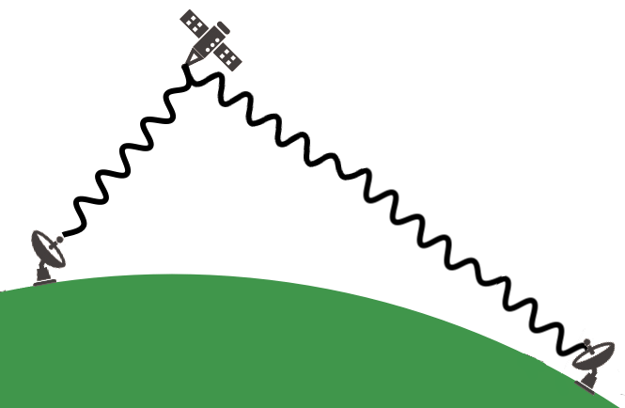
Radio waves with very short wavelengths (around 30 cm) are called microwaves.
These can also be used for radio communication.
These are aimed at a satellite which reflects the transmission back down to Earth.
Microwave transmissions can also be aimed directly at a nearby receiver. This is called a line of sight link.

Slide 8

There are two types of radio signal.
These are AM and FM.
You may have already noticed that radios have AM and FM options, but televisions can also receive an AM signal.

Slide 9
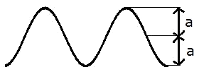
Both types of signal use a carrier wave to transmit a signal.
This is called modulation.
In AM signals, the amplitude of the carrier wave is varied to transmit a signal. They are amplitude modulated.
The frequency of the carrier wave is modified in FM signals. These waves are frequency modulated.

Slide 10
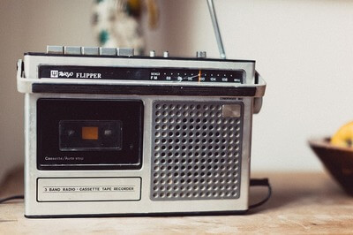
When the signal reaches the receiving antenna, the carrier wave is removed.
This leaves the original signal.
This signal is then amplified and directed to the speakers or television display.

Slide 11
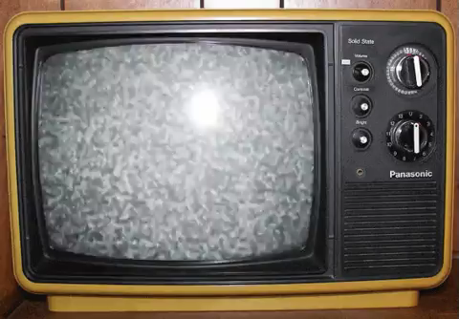
An AM signal consists of waves with wavelengths which are hundreds of metres long.
This long wavelength allows the signal to bend around obstacles, such as buildings or trees. This means an AM signal can travel further than a FM one.
However, these signals have a lower quality and suffer from interference, which leads to television static.

Slide 12
FM signals have wavelengths of approximately 3 m.
Waves with a short wavelength can not bend around obstacles, so FM signals do not travel as far.
However, these signals are higher quality and do not experience interference.

Slide 13
